Slide 1
Formulation Of Differential Equations and Circuit Dynamics
Prepared By
Asst. Prof. Uddhav Bhattarai
Cosmos College of Management and Technology

Slide 2
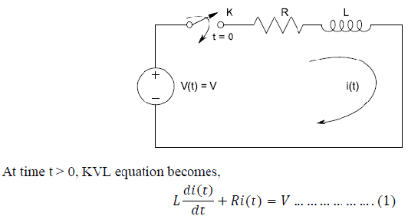
Formulation of Differential Equations
Use KVL or KCL by observing the given network for time t>0 i.e. after changing the position of switch.

Slide 3
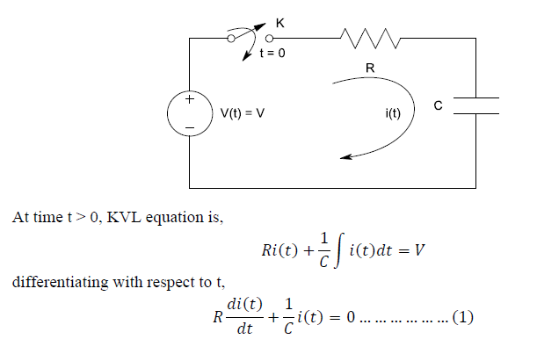
Formulation of Differential Equations Conti..

Slide 4
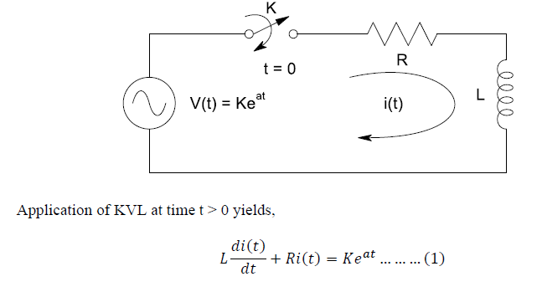
Formulation of Differential Equations Conti..

Slide 5
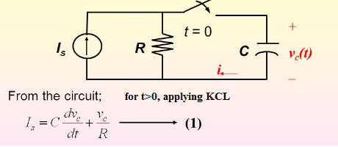
Formulation of Differential Equations Conti..

Slide 6
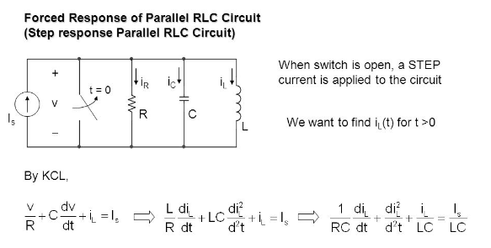
Formulation of Differential Equations Conti..

Slide 7
Circuit Dynamics
Please go through following steps, you will find them very helpful to solve network problems.
1. Write down the KVL/KCL equation for time t > 0.
2. Obviously, you will get differential equation. If equation consists of integral part, differentiate that equation with respect to time.

Slide 8


Circuit Dynamics Conti..
3. Assume the exponential type of transient response. Since it is the solution of homogeneous equation, the solution will be always exponential.
a) If roots are distinct, transient solution will be of the form,
b) If roots are repeated,
4.

Slide 9

Circuit Dynamics Conti..
4. Where value of s is obtained from characteristic equation (by representing homogeneous equation in terms of differential operator i.e. ).
5. Always remember that transient response does not depend on forcing function. It only depends on network parameters.

Slide 10
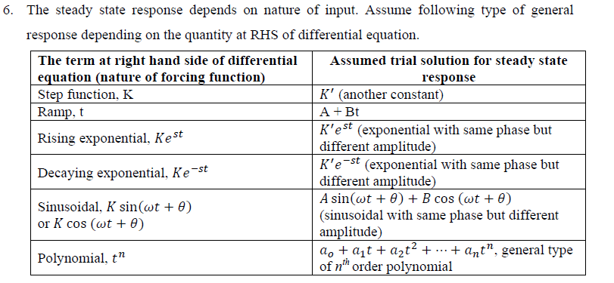
Circuit Dynamics Conti..

Slide 11
Circuit Dynamics Conti..
7. Total response will be the summation of transient response and steady state response (sometimes also known as forcing function as steady state response depends on nature of forcing function).
8. Find the constant if any, using initial condition.
9. Substitute the constant into total solution to get complete response.

Slide 12
Initial Conditions
The response of the network containing combination of lumped elements depends on switching action. Time 𝑡 = 0 refers to the instant of switching, in which the position of switch changes.
Time 𝑡 = 0− and 𝑡 = 0+ refers to the time just before and after switching.

Slide 13
Initial Conditions Conti…
Details of the history of network are of no importance. Only the values at the reference instants 𝑡 = 0− must be known. After switching at 𝑡 = 0+, new current and voltage may appear in the network as a result of initial capacitor voltage and inductor current or because of network voltage and current sources which are introduced. The evaluation of all voltage and current and their derivatives at 𝑡 = 0+ constitutes the evaluation of initial condition.

Slide 14
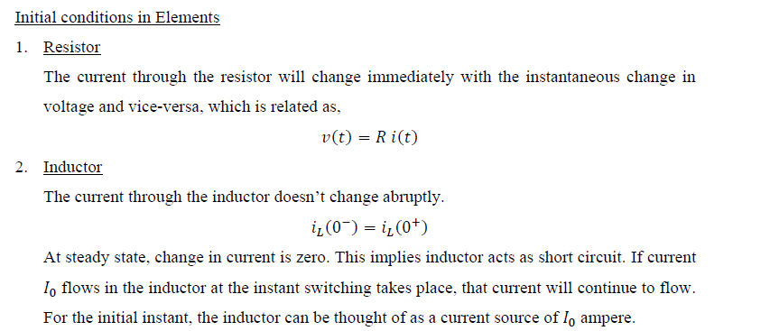
Initial Conditions Conti…

Slide 15
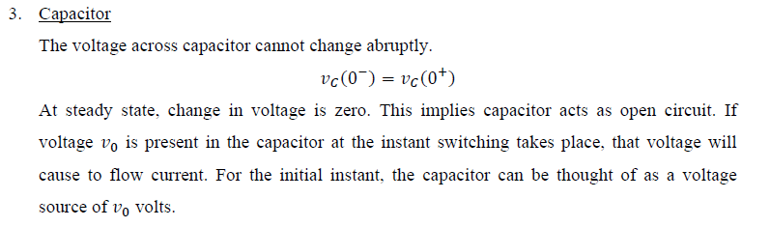
Initial Conditions Conti…

Slide 16
Initial Conditions Conti…
Procedure for evaluating initial condition
1. Replace every inductor by open circuit (if no current initially) or by a current source having current equal to that flowing at 𝑡=0+. The current through the inductor cannot change abruptly. When energy source is suddenly applied to an inductor, no current will flow initially. Thus, inductor acts as open circuit. If current is already flowing before switching action, the current will continue to flow.

Slide 17
Initial Conditions Conti…
2. Replace every capacitor by short circuit (if no voltage initially) or by a voltage source having potential equal to that flowing at 𝑡=0+. The voltage through the capacitor cannot change abruptly. When energy source is suddenly applied to a capacitor, no voltage will flow initially. Thus, capacitor acts as short circuit. If voltage is already present before switching action, the capacitor will continue to supply.

Slide 18
Initial Conditions Conti…
3. Leave every resister in the network unchanged.
4. Obtain the new equivalent network schematic at 𝑡=0+.
5. Find initial values of voltages and current.

